Slide 1
BIAS IN NETWORKS: LINK PREDICTION
Keith Burghardt
March 18, 2024

Slide 2
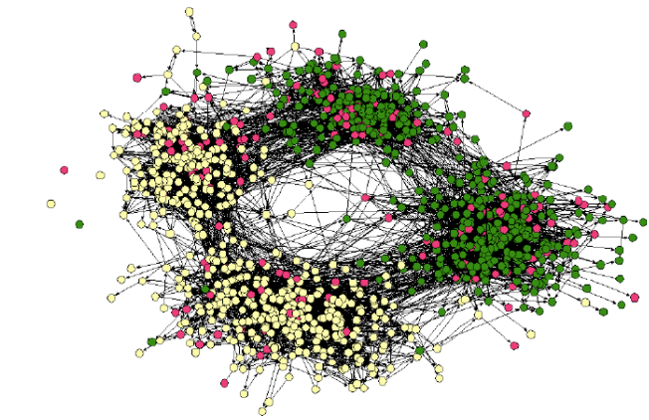
Bias in networks
Individuals are biased in their preferences for who to link to
Homophily (Lazarsfeld and Merton 1954): linked people tend to be more similar than a random pair of individuals
Homophily can organize the network into densely-connected, homogeneous components. The friendship network of high school & middle school students, color shows race, and divisions show high school vs middle school.
Figure: Credit: (Easley and Kleinberg, 2010)

Slide 3
Bias in Networks
Individuals are biased in their preferences for who to link to
Homophily: linked people are more similar than a random pair of individuals
aka “birds of a feather fly together”
Assortative mixing
E.g., people marry others who are demographically similar
Also applies to network structure: popular people more likely to be friends
Geometric/spatial constrains on friendships
Biased preferences shape social networks, with surprising effects
Small world effect
Emergence of structural bias, e.g., “glass ceiling”
Friends are a (systematically) biased sample of the population
Friendship paradox and consequences

Slide 4
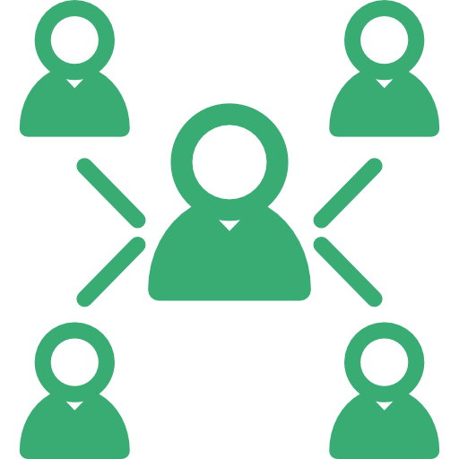




Other biases in networks
Positions within social networks (i.e., social connections) shape individual fitness, opportunities and well-being.
Positions with the social network are affected by
Cognitive factors: emotions, cognitive ability
Socio-economic factors: income, education, demographics
Positions within social network confer benefits
Job and promotion opportunities
Novel information
Inequality of opportunity
Glass ceiling effect
Ranking and visibility

Slide 5
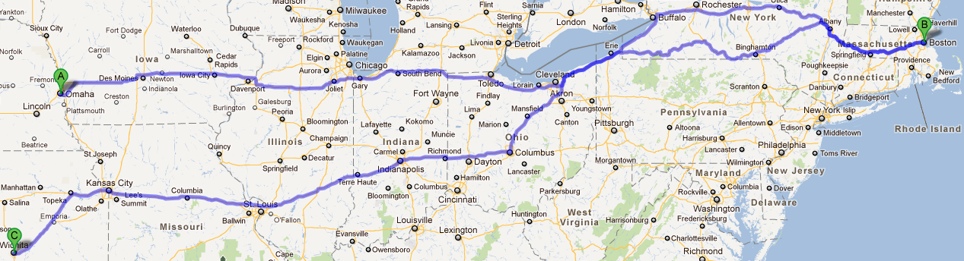
How large are social networks? The Milgram experiment (1963)
Stanley Milgram asked 160 random people in Kansas and Nebraska to deliver a letter to a stock broker in Boston.
If you do not know the target, do not try to contact him directly. Instead, mail this letter... to a personal acquaintance who is more likely than you to know the target... you must know this person on a first-name basis.
How long would it take?

Slide 6
The Milgram experiment
Within a few days the first letter arrived, passing through only two links.
Eventually 44 of the 160 letters made it to the target, some requiring close to a dozen intermediates.
The median number of steps in completed chains was 5.5
“six degrees of separation”

Slide 7
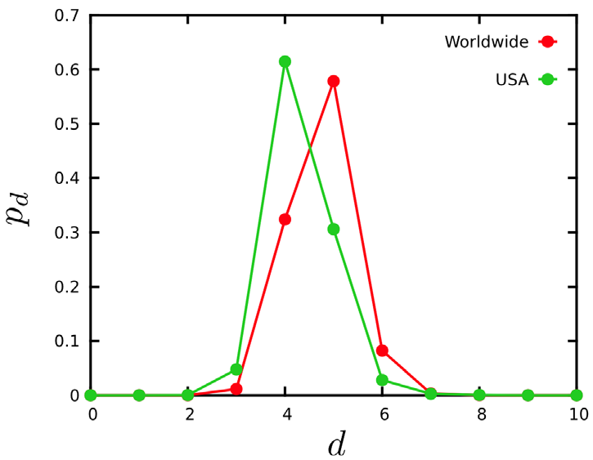
Facebook is a very small world
Ugander et al. directly measured distances between nodes in the Facebook social graph (May 2011)
721 million active users
68 billion symmetric friendship links
the average distance between the users was 4.74

Slide 8
Is this surprising?
People do not have global knowledge of network structure
They only know their own acquaintances
Despite this, people were able to create short chains to the target
Two fundamental aspects of networks
People are connected by relatively short chains, even over large geographic distances
Networks are “small” (small-world). Why is this surprising?
People are able to find these short chains using local information only
Networks are searchable

Slide 9
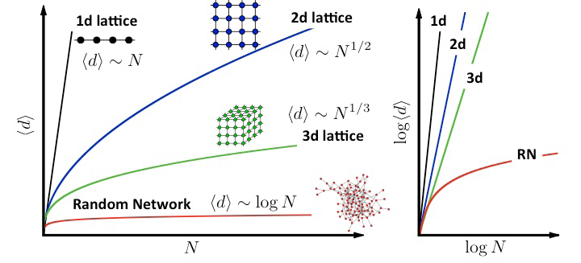
Why is it surprising?
Regular lattices (e.g., physical geography) do not have the small world property
Distances grow polynomially with system size
In networks, distances grow logarithmically with network size

Slide 10
Implications
Efficiently navigate network
Inefficiently navigate network

Slide 11
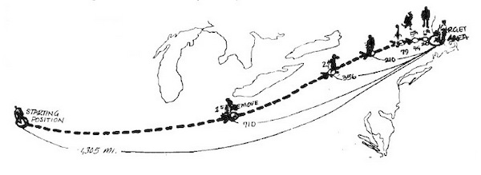
Social networks are searchable
Milgram experiments showed that
Short chains exist!
People can find them!
Using only local knowledge (who their friends are, their location and profession)
How are short chains discovered with this limited information?
Hint: geographic information?
[Milgram]

Slide 12
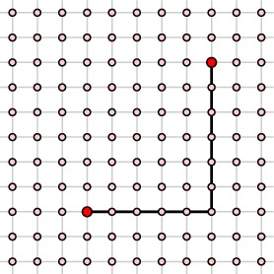
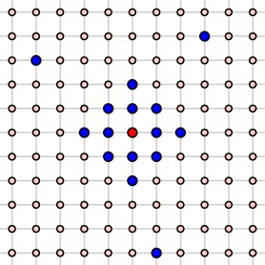
Kleinberg model of geographic links
Incorporate geographic distance in the distribution of links
Distance between nodes is d
Link to all nodes within distance r, then add q long range links with probability d^{-α}
Kleinberg, J. M. (2000). Navigation in a small world. Nature, 406(6798), 845-845.

Slide 13
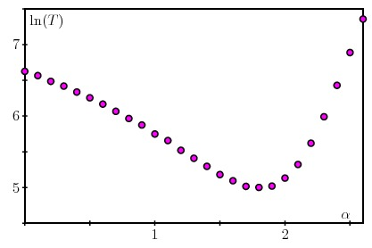
How does this affect short chains?
Simulate Milgram experiment
at each time step, a node selects a friend who is closer to the target (in lattice space) and forwards the letter to it
Each node uses only local information about its own social network and not the entire structure of the network
Network is searchable via a greedy algorithm when a=2
i.e., probability to form a link drops as square of distance
Given real networks do not satisfy this result exactly, we assume that real life is more complicated (moreover, this ignores lost messages)
delivery time
α

Slide 14
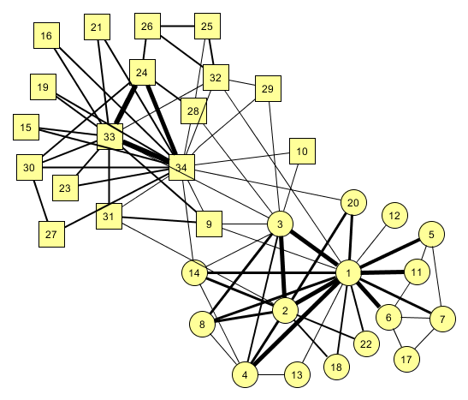
Strength of social ties
Granovetter 1973
link = social tie
Not all ties are created equal
Can macroscopic structure (i.e., network topology) predict microscopic (i.e., interpersonal) relationship?
How does microscopic structure (i.e., strength of social ties) affect macroscopic phenomena (e.g., spread of information)?

Slide 15
Social ties
Strength of a tie between two people is characterized by
Frequency and length of interactions
Emotional intensity of interactions
Intimacy, …
Strong ties vs weak ties
Strong ties
Friends
Family
Weak ties
Acquaintances
Co-workers
Neighbors

Slide 16
Measuring tie strength
Intensity and duration of social interactions is reflected in network structure
Consider nodes A and B
Set S={C, D, E, …} of all nodes tied to either or both A & B
Hypothesis: the stronger the tie between A & B, the larger the number of nodes in S to whom both A & B are tied
C
C
A
A
D
D
E
E
B
B
F
F

Slide 17
Measuring tie strength
Strong ties: large overlap in friendship circles
These people spend much time together
Weak ties: small overlap in friendship circles
These people occasionally spend time together
No ties: no overlap in friendship circles
C
C
A
A
D
D
E
E
B
B
F
F

Slide 18
A “bridge”
Bridge
a line in a network which provides the only path between two nodes, e.g., A-B
Link A-B provides the only route for information and influence to flow between communities
All bridges are weak ties
Weak ties play an important role in diffusion
A
B

Slide 19
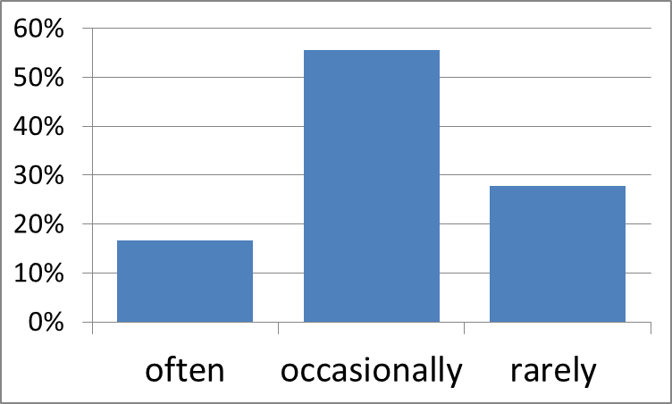
Weak ties & novel information: Job search study
Workers find out about new jobs through personal contacts
How does worker-contact tie strength affect chances of learning about the new job?
Measure tie strength by frequency of contact
Often (at least once a week)
Occasionally (less than 2x/week, more than 1x/year)
Rarely (1x/year or less)
What kind of contacts helped workers (N=54)
find jobs?

Slide 20
Job search study
Chance encounters with weak ties (college friends, former workmates) provided most of the job leads
“It is remarkable that people receive crucial information form individuals whose very existence they have forgotten”
What kind of contacts helped workers (N=54)
find jobs?

Slide 21
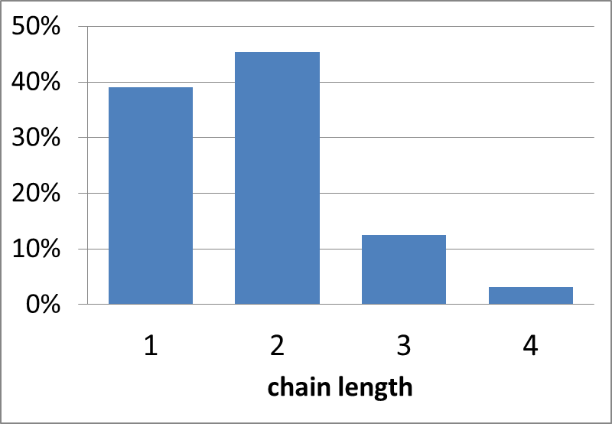
Length of chains
Granovetter traced job lead back to its source, i.e., where did the contact get information about the job from?
direct lead from the employer 🡪 length 1
Lead from a single intermediary 🡪 length 2
Similar to getting job lead from ad in newspaper

Slide 22
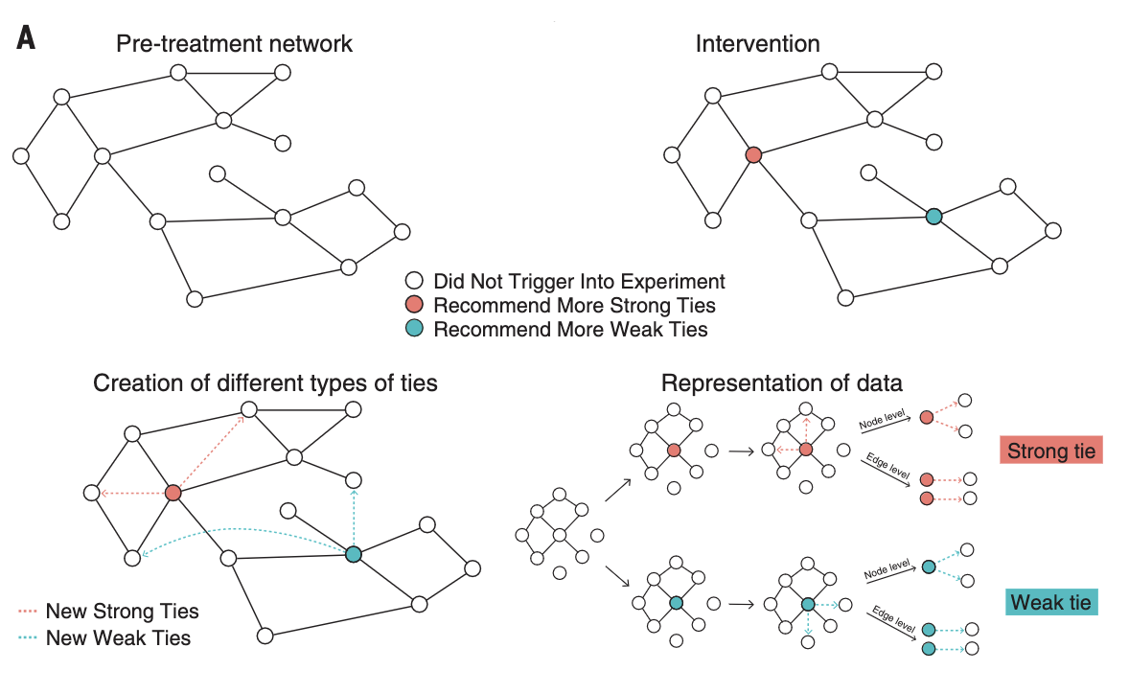
Further proof
Rajkumar et al., 2022

Slide 23
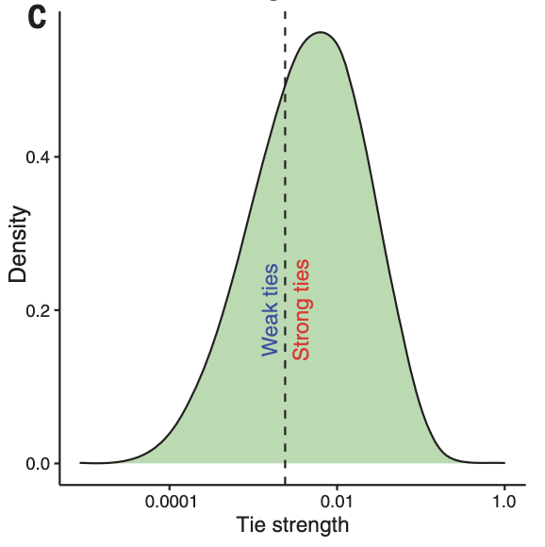
Weak ties based on tie strength
(If users have few friends in common they have weak ties)

Slide 24
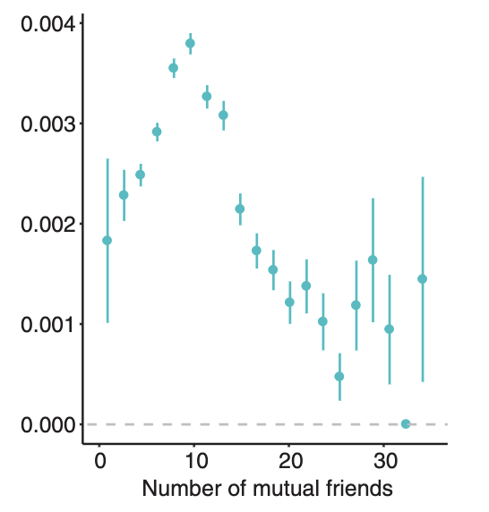
Strength of weak ties
Results show weak ties increase job likelihood based on interaction intensity…
Job transmission rate

Slide 25
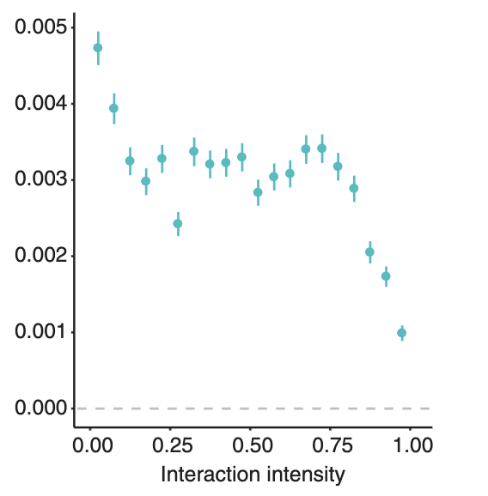
We see similar results for many mutual friends
Job transmission rate

Slide 26
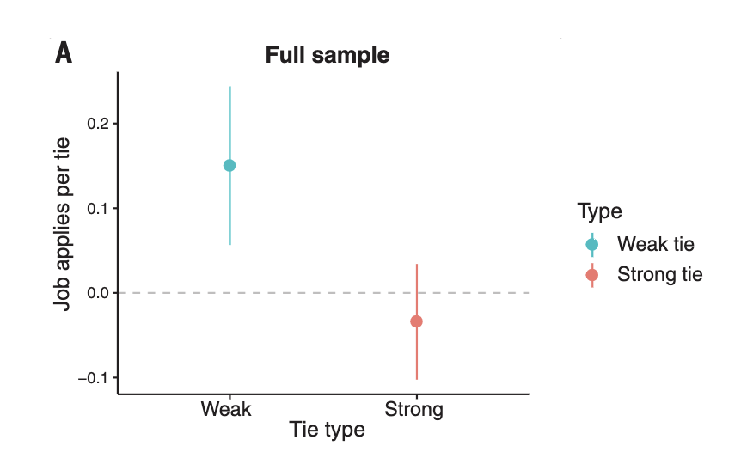
Weak ties matter!
Weak ties increase the chance of a job

Slide 27
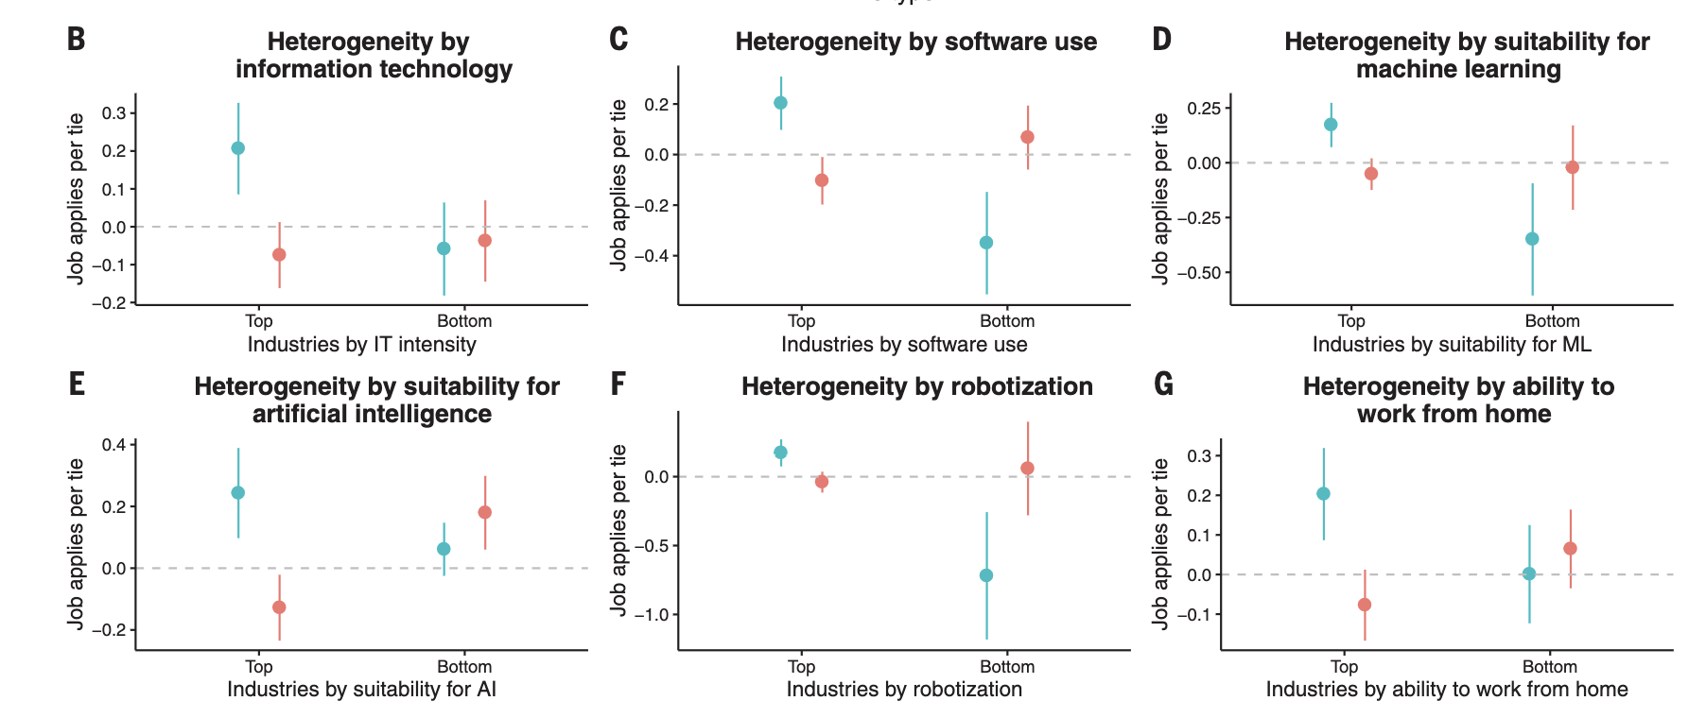
Effect varies by industry

Slide 28
Strength of social ties (review)
Strong ties
surrounded by many mutual friends
characterized by lots of shared time together
Weak ties
have few mutual friends
Serve as bridges to diverse parts of the network
Provide access to novel information

Slide 29
Link Prediction
Will nodes 33 and 28 become friends?
Does network structure contain enough information to predict what new links will form in the future?
What about nodes 27 and 4?

Slide 30
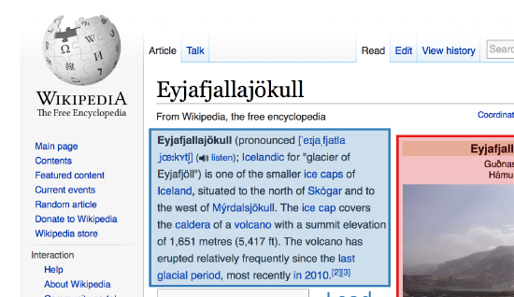
Link insertion & Web navigation
Help make web sites more searchable
Make it easier to find articles on Wikipedia
Direct traffic to overlooked products on online shopping Web sites

Slide 31
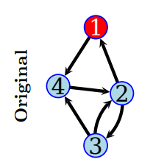
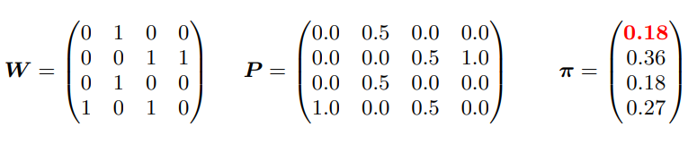
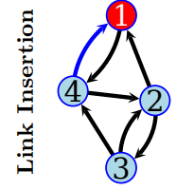
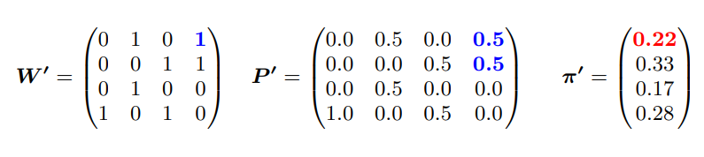
Link insertion and Web navigation
Adjacency matrix
PageRank
Insert a link to bias navigation toward a certain page
F Geigl, K Lerman, S Walk, M Strohmaier, D Helic Assessing the navigational effects of click biases and link insertion on the web - In Hypertext, 2016

Slide 32
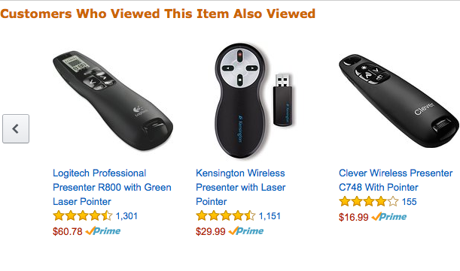
Item Recommendation

Slide 33
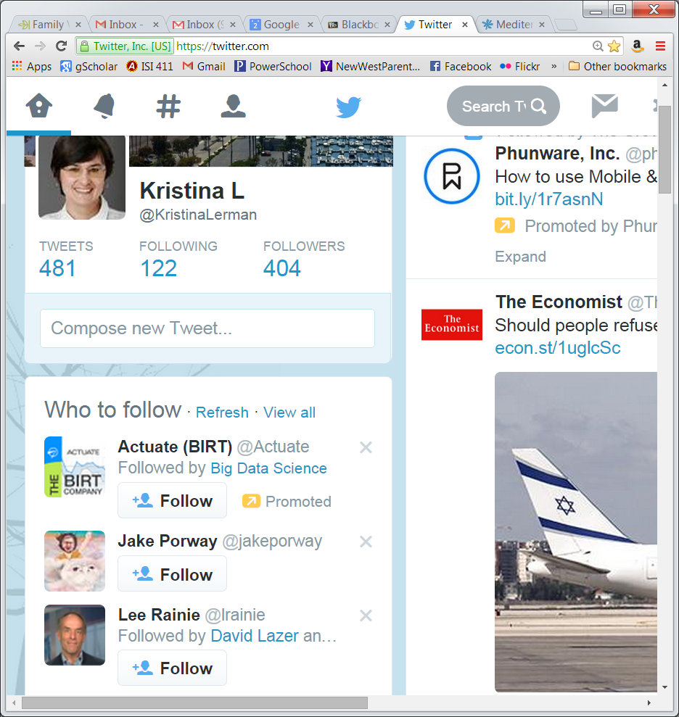
Who to follow

Slide 34
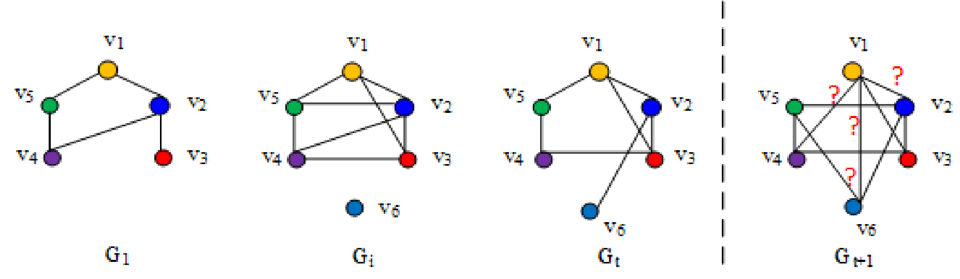
Link Prediction
Given a snapshot of a network, infer which new interactions between nodes are likely to occur in the future

Slide 35
Methods for Link Prediction
Graph heuristics based on measures for analyzing the “proximity” of nodes in a network.
Information Flow
Name visibility and attention
Graph embedding
Hybrid approaches

Slide 36
The Link-Prediction Problem for Social Networks (Liben-Nowell & Kleinberg)
To what extent can the evolution of a social network be modeled using features intrinsic to the network itself?
Formalize the link prediction problem
Given a snapshot of a network, infer which new interactions between nodes are likely to occur in the future
Propose link prediction heuristics based on measures for analyzing the “proximity” of nodes in a network.
Evaluate link prediction heuristics on large coauthorship networks. Future co-authorships can be extracted from network topology.

Slide 37
The intuition
In many networks, people who are “close” belong to the same social circles and will inevitably encounter one another and become linked themselves.
Graph heuristics measure how “close” people are
x
x
y
y
Red nodes are close to each other
Red nodes are more distant

Slide 38
Link prediction heuristics
Local
Common neighbors (CN)
Jaccard (JC)
Adamic-Adar (AA)
Preferential attachment (PA) …
Global
Katz score
Hitting time
PageRank …
x
y

Slide 39
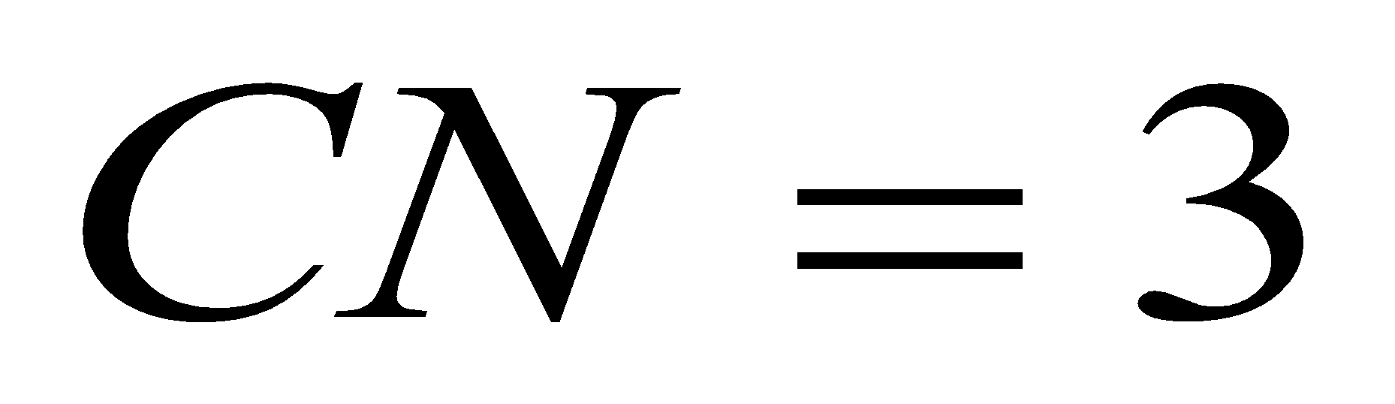
Local link prediction heuristics
Link prediction heuristics
Common neighbors (CN)
Neighborhood overlap
Jaccard (JC)
Adamic-Adar (AA)
Preferential attachment (PA)
x
y

Slide 40
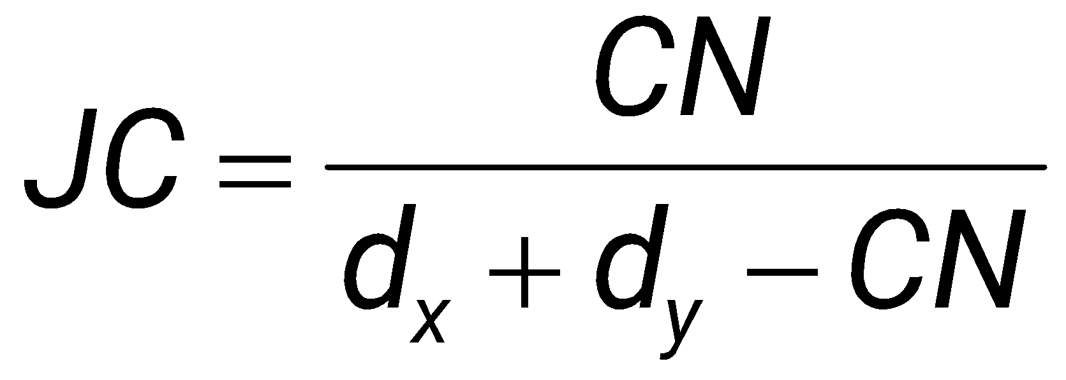
Local link prediction heuristics
Link prediction heuristics
Common neighbors (CN)
Jaccard (JC)
Fraction of common neighbors
Adamic-Adar (AA)
Preferential attachment (PA)
x
y

Slide 41
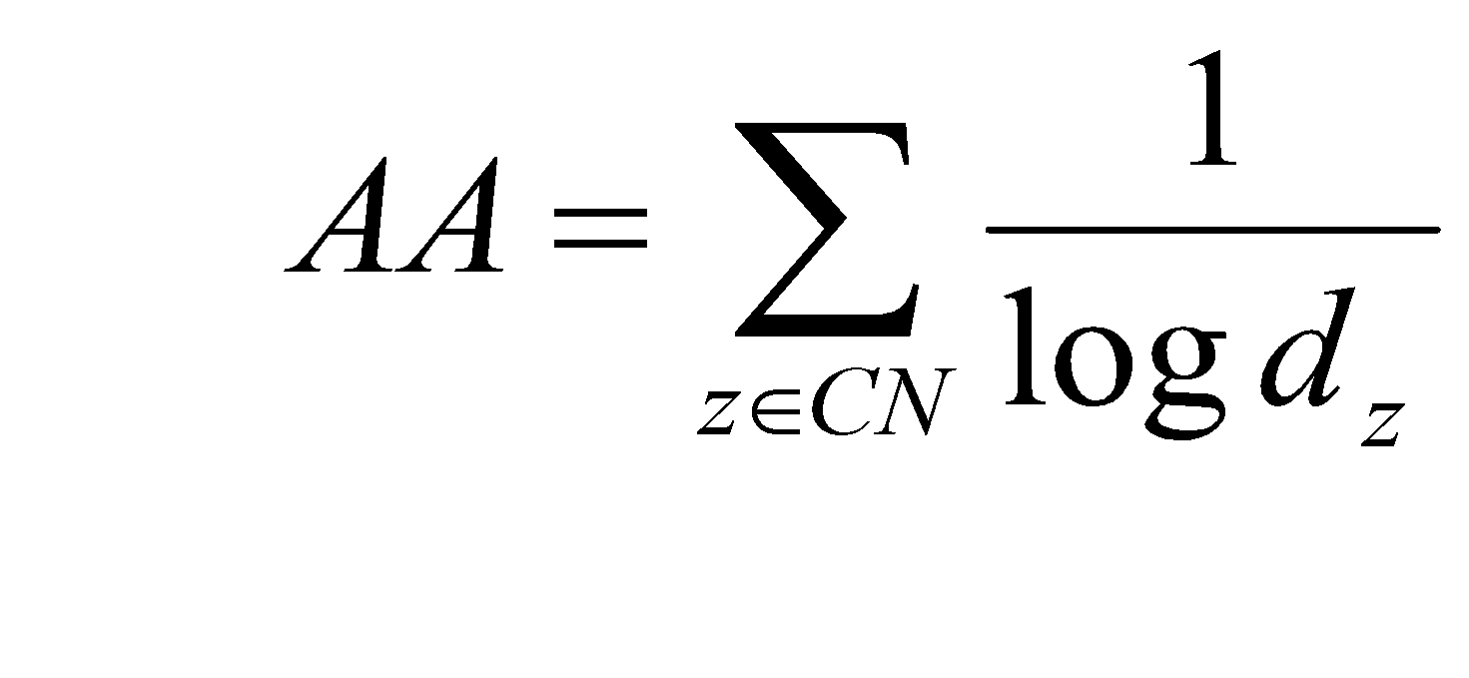
Link prediction heuristics
Link prediction heuristics
Common neighbors (CN)
Jaccard (JC)
Adamic-Adar (AA)
Nmbr common neighbors, with each neighbor z attenuated by log of its degree
Preferential attachment (PA)
x
y

Slide 42
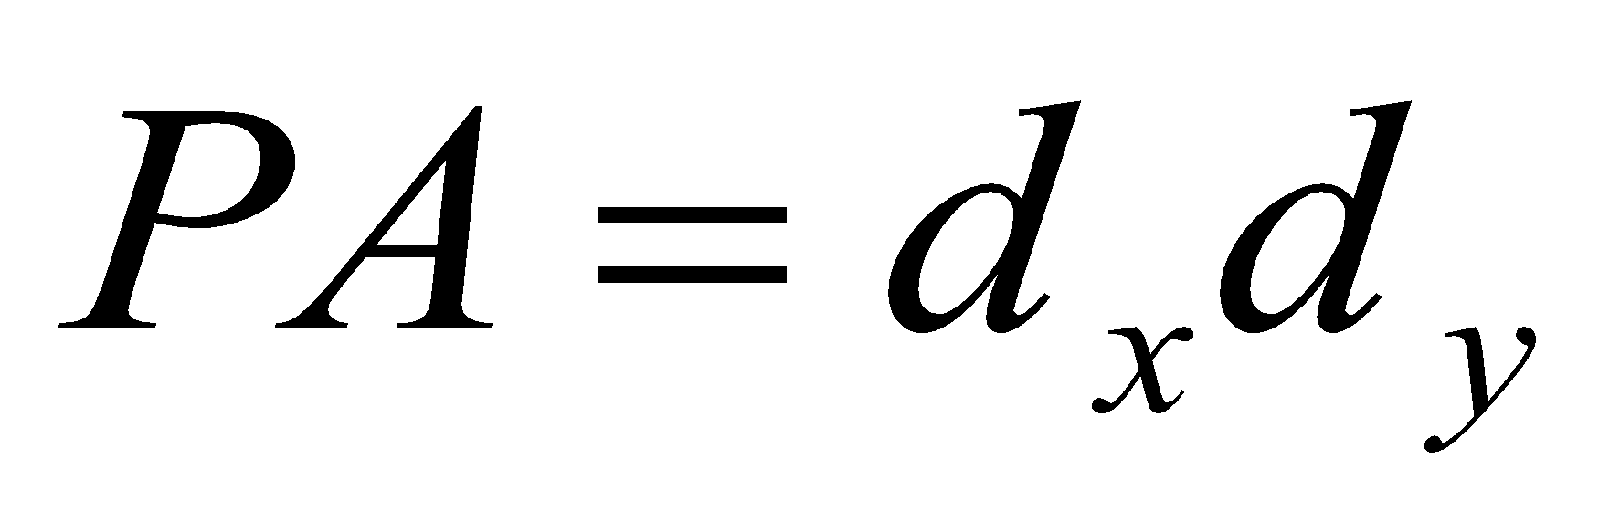
Local link prediction heuristics
Link prediction heuristics
Common neighbors (CN)
Jaccard (JC)
Adamic-Adar (AA)
Preferential attachment (PA)
Better connected nodes are more likely to form more links
x
y

Slide 43
Global link prediction heuristics
Link prediction heuristics
Katz score
Measures number of paths between two nodes, attenuated by their length
Hitting time
Expected time for a random walk from x to reach y
…
x
y

Slide 44
Which heuristic is the best?

Slide 45
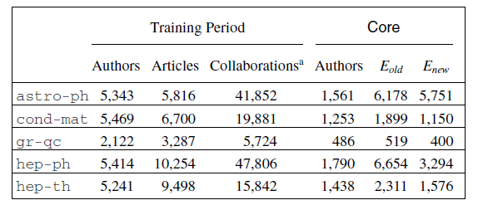
Data
Collaboration networks of physicists
Core nodes: authors who published at least 3 papers during the training period and at least 3 papers during test period
Training data: graph G(t₀, t₀’) of collaborations during time period [t₀, t₀‘] with V core nodes and E_{old} edges
Test data: graph G(t₁, t₁’) of collaborations during a later time period [t₁, t₁’] with V core nodes and E_{new} edges

Slide 46
Evaluation metric
Link prediction algorithm
Score node pairs using a heuristic p
New links more likely among high scoring pairs
Each link prediction heuristic p outputs a ranked list L of new collaborations: pairs in VxV-E_{old}.
Focus evaluation on new links E_{new}* between core nodes
Performance metric: How many of the top n pairs in ranked list L are the actual new nodes in E_{new}*?

Slide 47
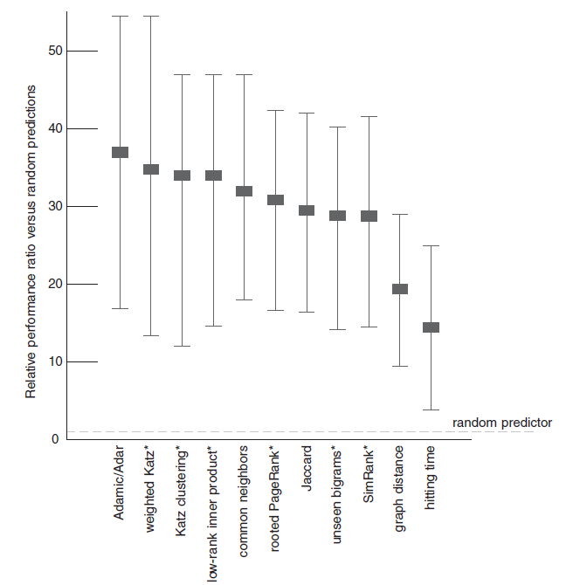
Results
Heuristics vs random predictor

Slide 48
NODE AND GRAPH EMBEDDING
Slides courtesy of Leskovec, Hamilton, Sosic

Slide 49
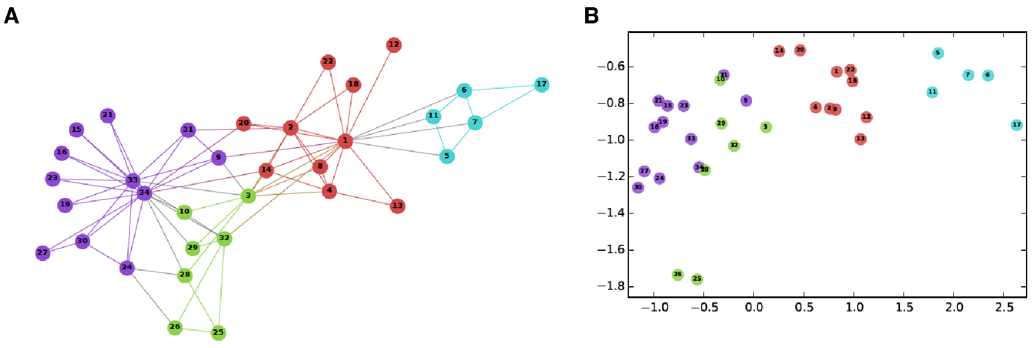
Node Embeddings
Input
Output
Intuition: Find embedding of nodes to d-dimensions so that “similar” nodes in the graph have embeddings that are close together.
cf Graph as text, and nodes as words.

Slide 50
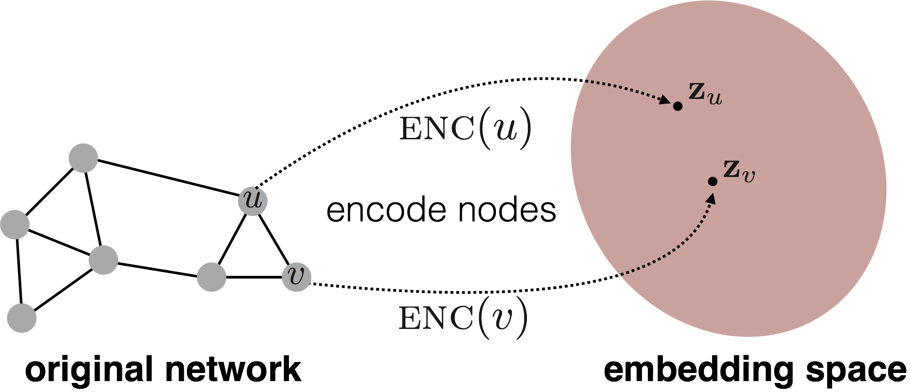
Embedding Nodes
Goal is to encode nodes so that similarity in the embedding space (e.g., dot product) approximates similarity in the original network.

Slide 51
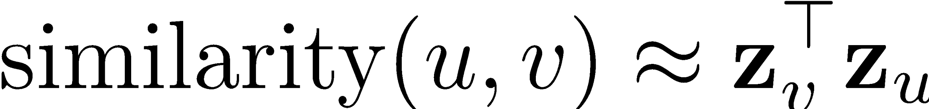
Learning Node Embeddings
Define an encoder (i.e., a mapping from nodes to embeddings)
Define a node similarity function (i.e., a measure of similarity in the original network).
Optimize the parameters of the encoder so that:
Notes:
Note that other distance measures other than dot products could be used (e.g., Euclidean distance), but the dot product is the standard measure of similarity used.

Slide 52
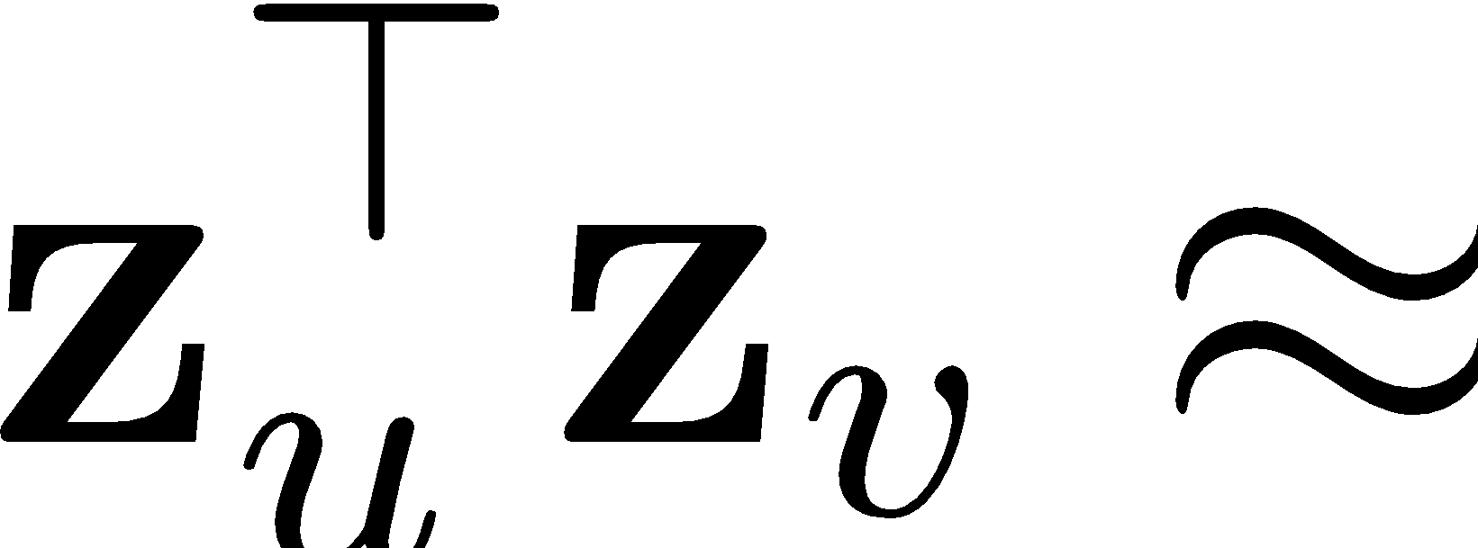
Random-walk Embeddings
probability that u and v co-occur on a random walk over the network

Slide 53
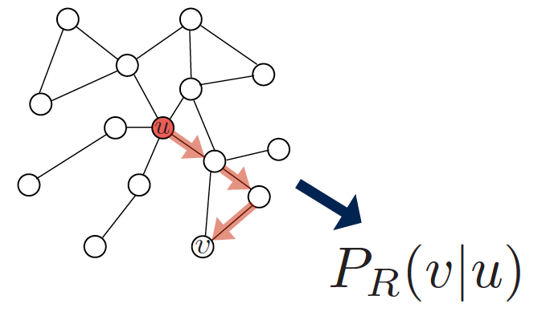
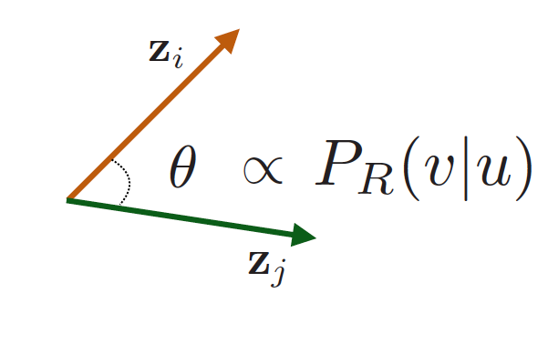
Random-walk Embeddings
Estimate probability of visiting node v on a random walk starting from node u using some random walk strategy R.
Optimize embeddings to encode these random walk statistics.

Slide 54
How should we walk on a graph?
What strategies should we use to run these random walks?
DeepWalk: runs fixed-length random walks starting from each node. Preserve higher-order proximity between nodes by maximizing the probability of observing the last k nodes and the next k nodes in the random walk centered at node.
Node2vec: In contrast to DeepWalk, node2vec employs biased random walks that provide a trade-off between breadth-first and depth-first graph searches, and hence produces more informative embeddings than DeepWalk.

Slide 55
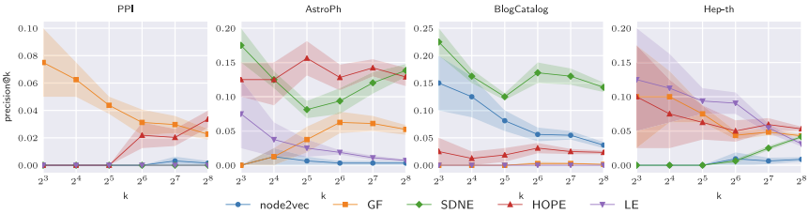
Link Prediction with Embeddings
Hide 20% of the links in a graph and attempt to reconstruct them.
Rank pairs of node according to similarity (high similarity means they should be linked)
Precision of top k predicted links
Some methods perform better than others depending on data
https://pdf.sciencedirectassets.com/271505/1-s2.0-S0950705118X00112/1-s2.0-S0950705118301540/main.pdf
Notes:
Goyal, P., & Ferrara, E. (2018). Graph embedding techniques, applications, and performance: A survey. Knowledge-Based Systems, 151, 78-94. https://pdf.sciencedirectassets.com/271505/1-s2.0-S0950705118X00112/1-s2.0-S0950705118301540/main.pdf

Slide 56
Fairness

Slide 57
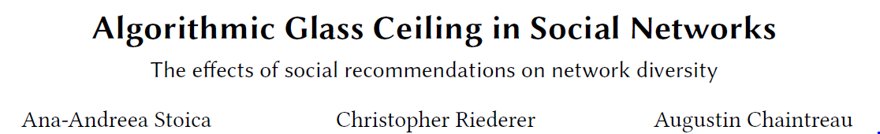
algorithmic glass ceiling: link recommendation algorithms affect degree distributions and decrease female representation
Mathematical analysis of conditions creating the glass ceiling effect
Propose a recommendation algorithm that mitigates some of the biases

Slide 58
Data collection
Crawl Instagram’s public profiles
Through the Instagram API, collect profile information and recursively followed the lists of followers.
Profile name, username, unique id,
Photo meta-data: unique photo id, number of likes, number of comments, hashtags, location, timestamp, tagged users
In total, 115, 796, 284 photos from 245, 038 different users over multiple months of 2014 and 2015.
Labeled genders of 92, 935 users: 53%, female and 47% male

Slide 59
Instagram activity graph
Instagram activity graph
1 million randomly sampled photos with 3-5 comments sampled from them
Create an edge between photo’s author and users who comment on it
553,628 nodes and 652,931 edges,
54% female
DBLP graph
Co-authorship graph
102, 263 nodes and 199, 679 edges,
19.3% female

Slide 60
Organic growth vs growth by recommendation
Organic growth
While females are 54% of the population, they represent
48% of users with degree > 10 (top 1%)
45% of users with degree > 2000
Recommendation
Use Adamic-Adar index to recommend new links
Suggests links to nodes with most common neighbors
Random walk recommendation
Choose a 2-hop neighbor at random

Slide 61
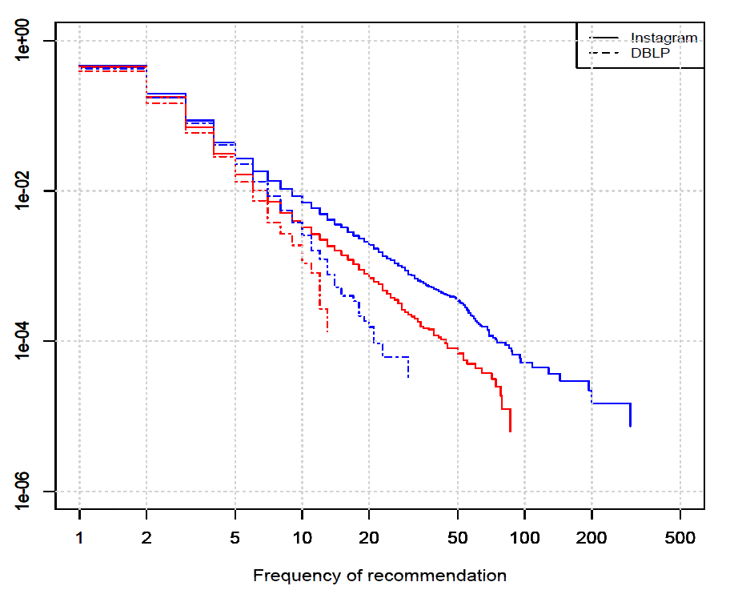
Bias under algorithmic link recommendation
CCDF
Glass ceiling effect
Notes:
Complementary cumulative distribution function

Slide 62
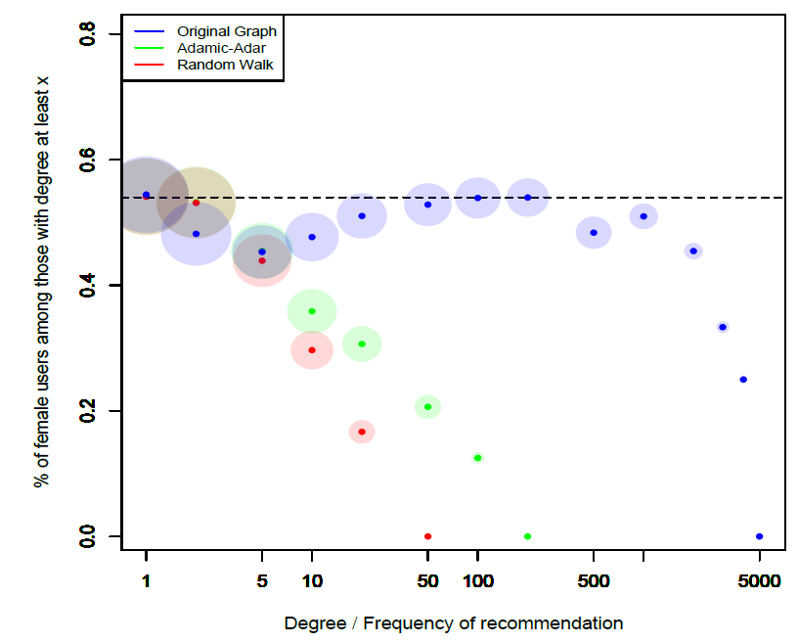
Representation of women within top-recommendations
Relative fraction within Instagram network
Relative fraction within recommendations

Slide 63
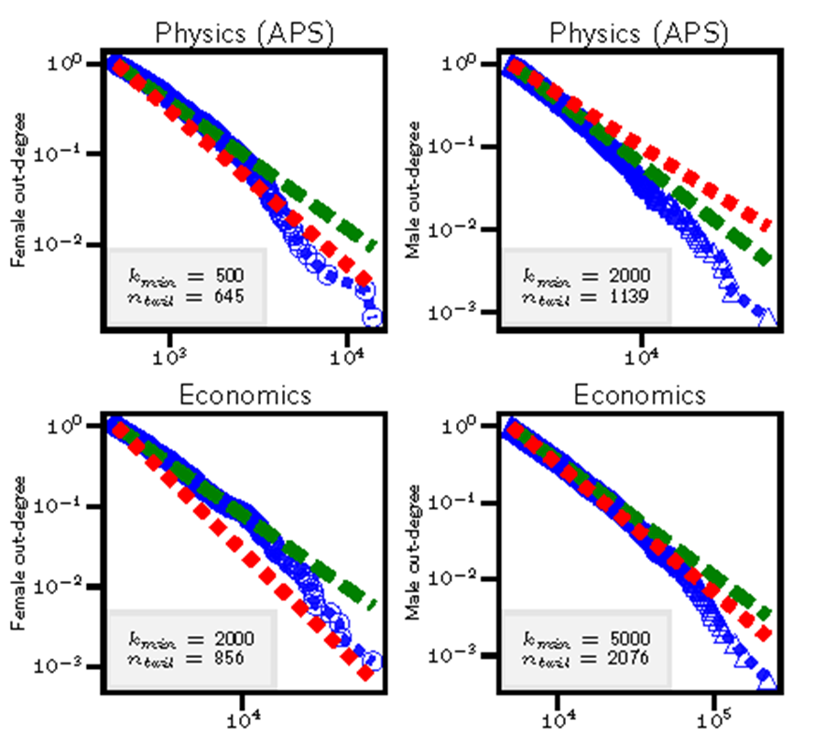
Glass ceiling in science
Number of citations is highly skewed
Most researchers have only a few citations, while a small number of researchers have large number of citations
Citations are highly skewed for men
Top men researchers have more citations than top women researchers
Google scholar searches?
women
men
women
men
Number of citations

Slide 64
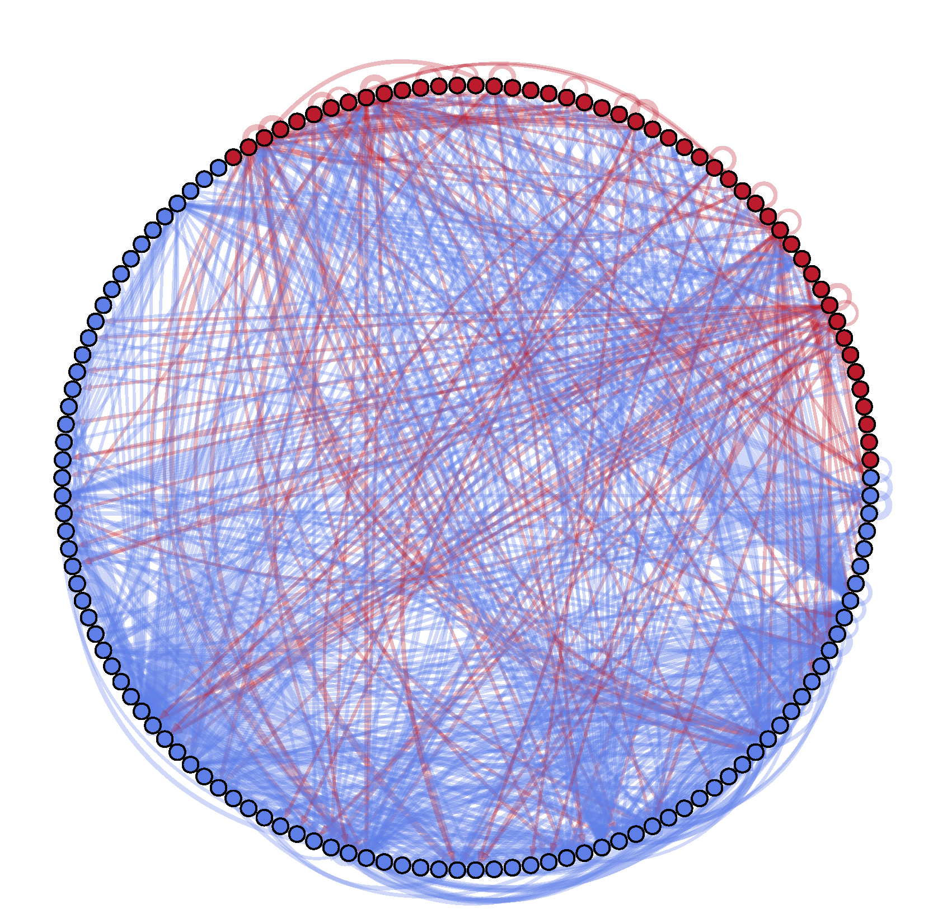
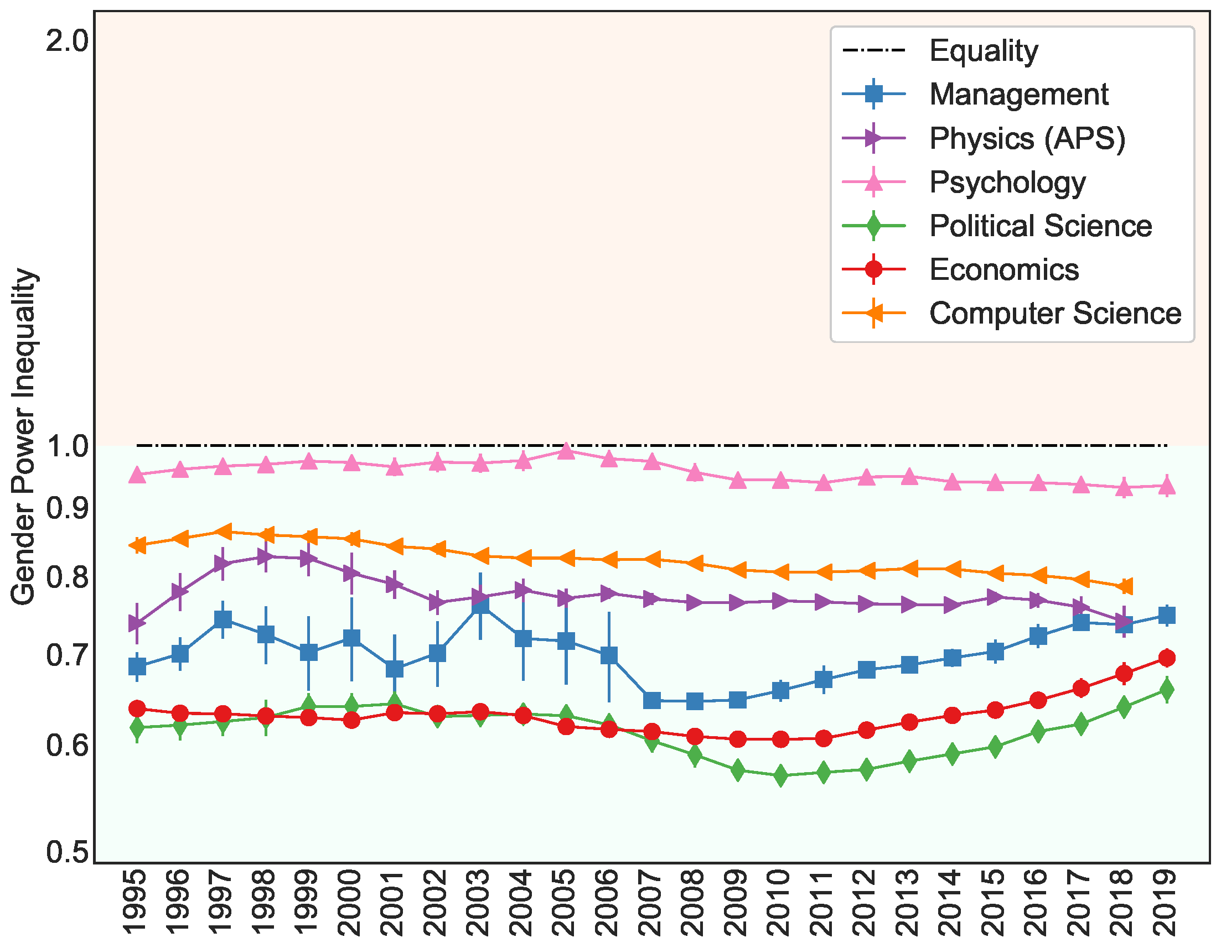
Gender disparity in citations
d_{o}(v): the number of authors who cite v (influence)
d_{i}(v): the number of authors cited by v
Power inequality:
Which group has more influence: Red or Blue?
I=d_{o}(Red)/d_{i}(Red) * d_{i}(Blue)/d_{o}(Blue)
Subgraph of author-citation network: women are red, men are blue
Source: https://arxiv.org/abs/2103.10944

Slide 65
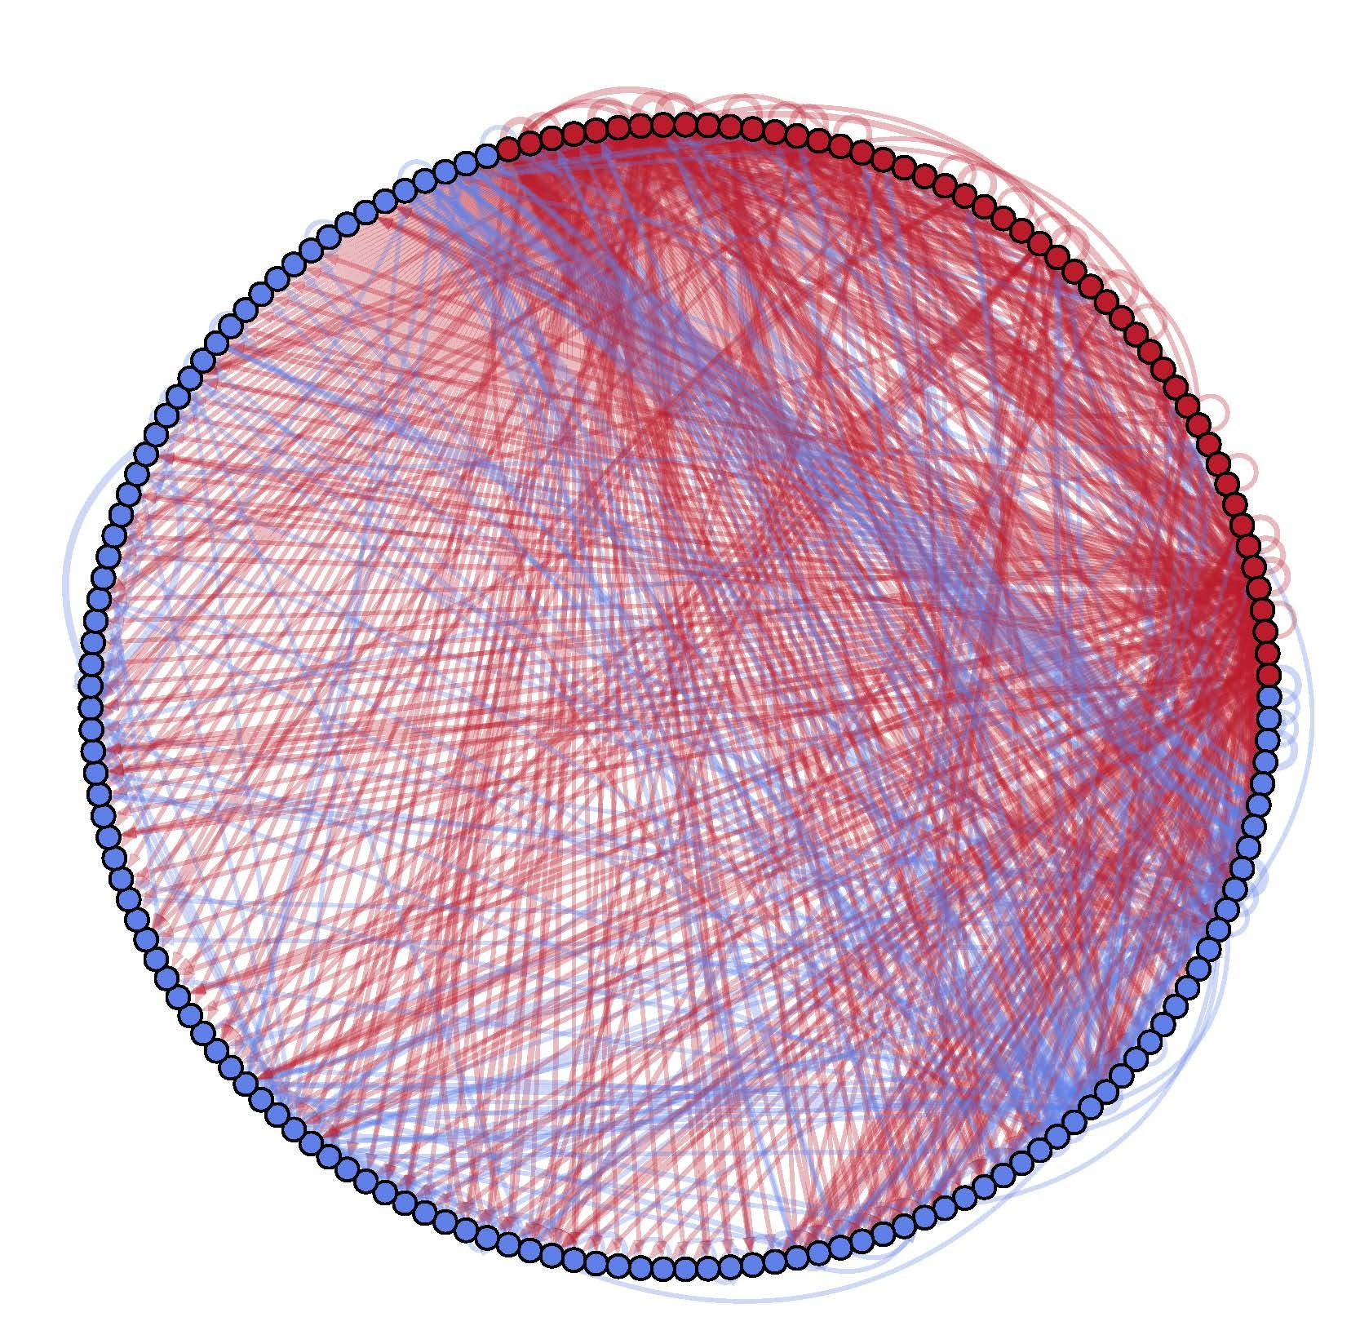
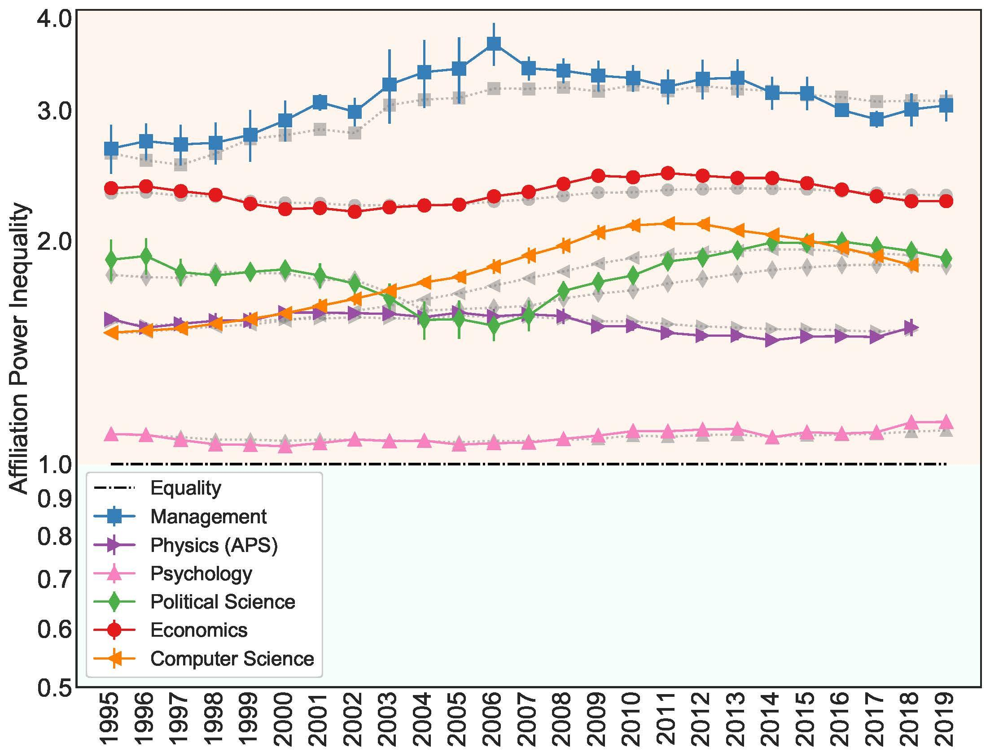
Prestige bias in citations
d_{o}(v): the number of authors who cite v (influence)
d_{i}(v): the number of authors cited by v
Power inequality:
Which group has more influence: Red or Blue?
I=d_{o}(Red)/d_{i}(Red) * d_{i}(Blue)/d_{o}(Blue)
Subgraph of author-citation network: authors from elite schools are red, non-elite are blue
Source: https://arxiv.org/abs/2103.10944

Slide 66
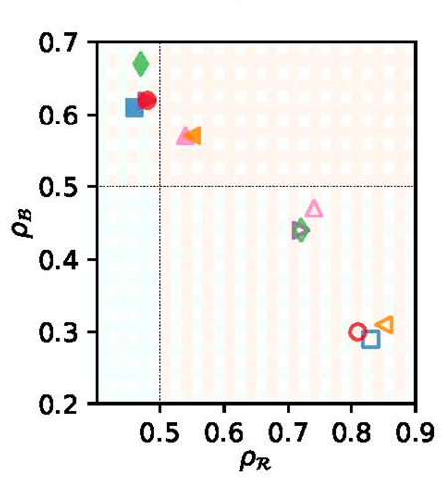
Homophily creates citations disparity
Measure homophily from citations data
Preference of Red authors to cite other authors
ρ_{R} > 0.5 means Red authors prefer to cite other Red authors
ρ_{R} < 0.5 means Red authors prefer to cite Blue authors
Gender Disparity:
Blue (men) are homophilic (ρ>0.5).
Red (women) are mostly heterophilic.
Prestige Disparity:
Red (elite institutions) are homophilic.
Blue (non-elite) are heterophilic.
Notes:
Cumulative advantage amplifies biases in individual preferences (homophily)

Slide 67
Takeaways
Homophily plays a central role in the glass ceiling effect
Homophily creates advantages for some groups
Reducing disadvantages in networks?

